Slide 1



R Programming
Nadav Rindler nrindler@gmail.com
Session 02
23 Sept 2017
Image: tryr.codeschool.com

Slide 2



Workshop Format
30 minutes : Introduction & concepts
120 minutes : Hands-on exercise

Slide 3
What is R?
Programming language
Software environment
Widely used for statistical modeling, data analysis, and graphics
Efficient data structures make programming very easy
Extendable through 11,000+ user-created packages available on Comprehensive R Archive Network (CRAN) website
Rstudio IDE includes integration with Shiny (interactive web apps), Rmarkdown (publishing), and Git (version control)

Slide 4
Advantages of R
Streamline analytics workflow within a single platform
Free, open source, compatible across OS
Active development and user community
Quick install and set-up
Powerful visualizations, including interactive maps and dashboards
Ability to run on desktop or server-side (e.g., Amazon AWS hosting)
Can connect with a wide range of SQL databases and run queries in-database without transferring data
Wide range of analytics functions beyond modeling, including text mining, sentiment analysis, mapping

Slide 5
Disadvantages of R
Steep learning curve
Coding environment, not point-and-click, for technical users
Many ways to do the same thing (variety of packages)
Completely different syntax between R, R Markdown, and Shiny
Runs in-memory – advanced methods required to handle data outside memory
Tradeoff – not the only open source option, many data scientists use Python, TensorFlow, etc.

Slide 6
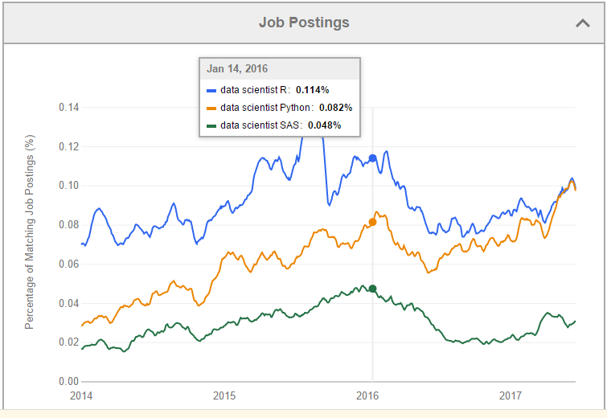
Why R?
Source: Indeed.com

Slide 7









R in the Wild: Many companies use R

Slide 8
When to use R
Use the easiest tool for the job. For data analysis, that’s often Excel. But Excel won’t work for certain tasks:
Size. Data set is too large for Excel.
Complexity. Bringing together many data sources, using merges/joins and group-by’s
Advanced analytics. Access to a wider range of functions and tools for statistics, modeling, visualization, mapping, etc.
Reproducibility / Automation. Code is a record of what was done and can therefore be reproduced or automated. Excel is good for 10 charts…what about 10,000?

Slide 9
Core Concepts
Variables Assignment, Naming
Operators Conditions, Logical
Conditional statements IF and IFELSE
Loops
Creating Functions
Data Types Logical, Numeric/Integer, Character, Factor
Objects Vector, Matrix, Array, Data Frame, List
Indexing
Built-in functions Math, Statistics, String/Regex
Environment Working directory, Libraries

Slide 10
Variable Assignment
> a = 49 numeric
> sqrt(a)
[1] 7
> b <- “The dog ate my homework” character
> sub("dog","cat",b)
[1] "The cat ate my homework“
> c <- (1+1==3) logical
> c
[1] FALSE
Variable assignment uses “=“ or “<-” operators... to test for equivalence, use “==“
Do not need to specify the data type or object type of a variable
Variable names can be assigned to any type of R object
The data type of the R object becomes the data type of the variable

Slide 11
Naming Conventions
Can be a combination of letters, digits, period (.) and underscore (_)
Must start with a letter or a period. If it starts with a period, it cannot be followed by a digit
Reserved words in R cannot be used as identifiers
Variable names are case sensitive
Which variable names are valid?
TRUE true
total tot@l
Sum sum
Number5 5um
.starts.with.dot .0ne
_is_this_acceptable is_this_acceptable

Slide 12
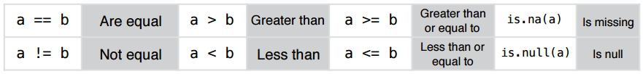
Operators
Conditional operators
Remember, “=“ and “<-” operators are reserved for variable assignment
Logical operators
& and
| or
! not

Slide 13
Conditional Statements
IF STATEMENT operates on length-one logical vectors.
Syntax
> if (test_expression) { statement }
Example
x <- 5
if(x > 0){ print("Positive number") }
IFELSE STATEMENT operates on vectors.
Syntax
> ifelse(test, true_value, false_value)
Example
x <- 1:10
ifelse(x<5, x, 0)
[1] 1 2 3 4 0 0 0 0 0 0

Slide 14
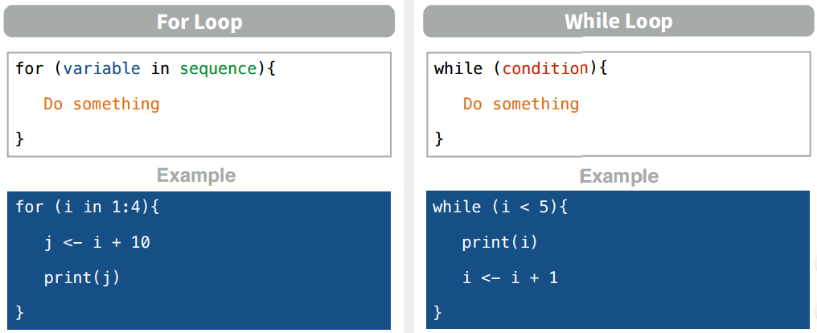
Loops
FOR loop iterates once per item in sequence
WHILE loop iterates once per item in sequence while condition is TRUE

Slide 15
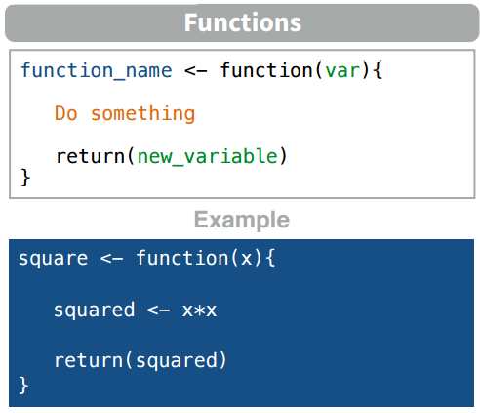
Functions
To call function: function(arg1=… , arg2=… )
e.g. square(4) square(x=4)

Slide 16
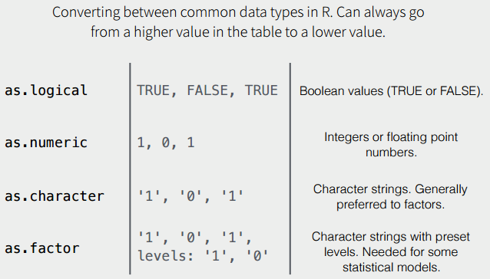
Data Types
Data types include numeric/integer, character, factor, and logical
Factors – character strings taking pre-defined values or ‘levels’. A factor variable with ordered levels is ordinal
Test data type using is.numeric(). Convert between data types using as.numeric()

Slide 17
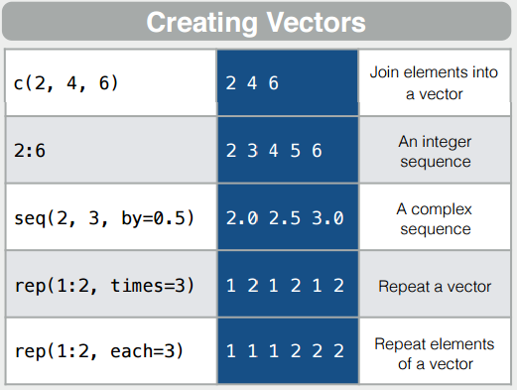
Vectors
Vector – an ordered collection of data of the same type (1-dimensional)
Can be numeric, character, logical
In R, a single number is the special case of a vector with 1 element

Slide 18
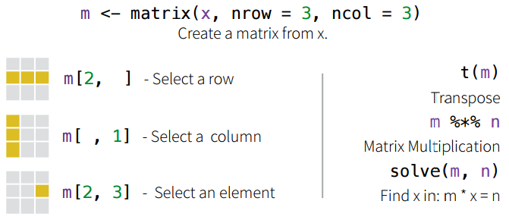
Matrices
Matrix – rectangular table of data (2-dimensional)
All data in matrix must be of the same type (numeric, character, etc.)
Array – same as a matrix but with more than 2 dimensions
Example: the red and green foreground and background values for 20,000 spots on 120 chips: a 4 x 20,000 x 120 (3D) array.

Slide 19
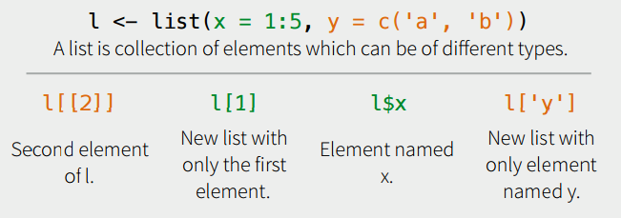
Lists
List – Ordered collection of data
Elements in list can be of any data type (numeric, character, etc.)
Nesting: Can have a list of lists
Typically, vector elements are accessed by their index (an integer), list elements by their name (a character string). But both types support both access methods.

Slide 20
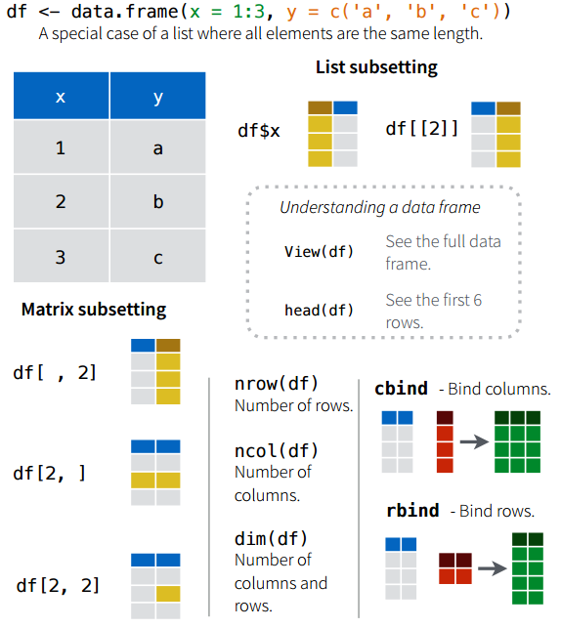
Data Frames
Data frame – Table for storing data
Columns in df can be of any data type (numeric, character, etc.)
Can have row names and column names
A df is a list of equal-length vectors

Slide 21
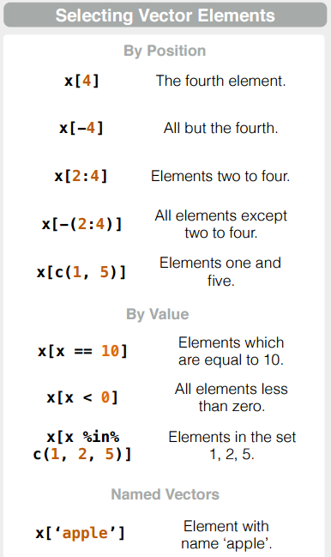
Selecting Elements
Retrieve elements from an object by position, value, or name
Position
Single element: x[4]
Sequence of elements: x[2:4]
Non-continuous elements: x[c(1,5)]
List elements x[[2]]
Value
Use condition statements
Name
Single element x[‘apple’]
x$apple
Multiple elements x[c(‘apple’,’pear’)]
For 2D object, index is df[row, column]

Slide 22
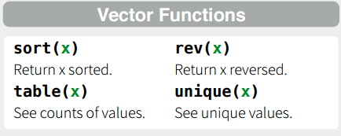
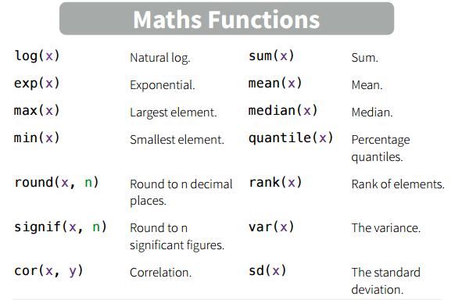
Built-in Functions
Many built-in functions for statistics, distributions, strings, plotting…

Slide 23
Environment
At start of session, set working directory to point R to folder to read/write files
Each R package (beyond built-in functions) must be activated at the beginning of each session using library() or require(). New packages must be installed using install.packages() (only need to install a new package once).
Functions to read and write files are specific to each file type (Rdata, csv, Excel, txt, etc.)
Use environment panel in RStudio to browse stored variables, objects, and functions
Access help and documentation by typing ?function in R console (e.g., ?mean)

Slide 24


Looking for help?
Coders’ best friends…

Slide 25
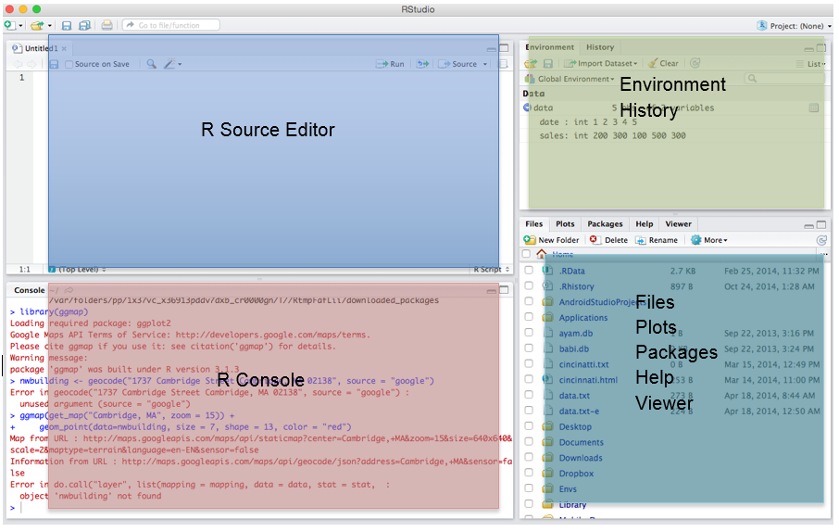
RStudio

Slide 26
Hands-On Exercise

Slide 27
References
https://www.indeed.com/jobtrends/q-data-scientist-R-q-data-scientist-Python-q-data-scientist-SAS.html
https://www.rstudio.com/wp-content/uploads/2016/10/r-cheat-sheet-3.pdf
http://www3.nd.edu/~mclark19/learn/Introduction_to_R.pdf
http://faculty.ucr.edu/~tgirke/HTML_Presentations/Manuals/Workshop_Dec_6_10_2012/Rprogramming/Programming_in_R.pdf
http://www.programiz.com/r-programming
http://www.r-tutor.com/r-introduction/data-frame/data-frame-row-slice
http://www.statmethods.net/management/functions.html

Slide 28
Resources
http://www.r-project.org/
CRAN
RStudio
R cheat sheet
Data Science in R free online textbook by Hadley Wickham
R Fiddle online R interface (if having trouble installing R on your machine)
http://tryr.codeschool.com/

Slide 29


Got Questions?
Nadav Rindler
nrindler@gmail.com
https://www.linkedin.com/in/nrindler/
Shak Hassan
eskep01@gmail.com
Twitter: @shakhassan
https://my.linkedin.com/in/shakhassan25

